Slide 1
CSV Parsing in Python

Slide 2
Shebang line
#!usr/bin/env python3
Found on top of most python files
Line that tells unix OS which binary to run file with when file is run as an executable
Compatibility between Python 2.7 and Python 3.x

Slide 3
Interactive editor
Python + version in command line
Print command
print(“Hello, world”)
Help tool
help(any object), everything is an object in python

Slide 4
Common Types in Python
Int
myInt = 1
String
myString = “Hello, World”
No concept of characters in Python (in practice)
List
myList = [1, 10, 13, 15]
print(myList)
print(myList[0])
Dictionary
myDict = {‘aKey’: “Hello, World”}
print(myDict[‘aKey’])
Tuples
myTuple = 123, 321, “Hello, World”
https://docs.python.org/3/tutorial/datastructures.html
https://docs.python.org/3/library/stdtypes.html

Slide 5
Variables and Functions
Variables are pieces of data with symbolic names
myString = “Hello, World”
print(myString)
Functions are named groups of repeatable instruction
def print_string(string):
print(string)
myString = “Hello, World”
print_string(myString)

Slide 6
Operators and Assignment
Normal math applies
Normal order of operations apply
Assignment to the left
Some additional operators such as **, %, and //
https://www.tutorialspoint.com/python/python_basic_operators.htm
myVariable = 0
myVariable = 5 + 10 * 3 – 5
print(myVariable)

Slide 7
Arguments and returns in functions
Functions can take variable arguments
Functions can return a value, or object created/calculated in a function
def this_is_a_test_function(oneArg, twoArg, threeArg):
result = oneArg + twoArg – threeArg
return result
calculation = this_is_a_test_function(5, 10, 3)
print(calculation)

Slide 8
Conditionals
if statement
else statement
elif statement
Chain ifs
if myString == “Hello, World”:
print(myString)
if myString == “Hello, World”:
print(myString)
else:
print(“Goodbye, World”)
if myString == “Hello, World”:
print(myString)
elif myString == “Goodbye, World”:
print(“Goodbye, World”)
else:
print(“I dunno”)

Slide 9
Conditionals
Can use common conditional operators (c like) such as
==, equal to
!=, not equal to
<, >, less than, greater than
<=, >=, less than or equal to, greater than or equal to
True or false conditionals
&&, this and this are both true
||, one of these are true

Slide 10
Pythonic Binary comparisons
Preferred to use words
And
or
not
is
Can say is true or is not true
myBool = True
mySecondBool = False
If myBool:
print(“myBool is True”)
If not myBool:
print(“myBool is not True”)
If myBool is True:
print(“myBool is True”)
If myBool or mySecondBool:
print(“One of these is true”)
If myBool and mySecondBool:
print(“Both of these are true”)

Slide 11
Quick Check on Learning
Write three functions that add, subtract, and multiply respectively
Write a function that runs each function on two ints based on a second argument string, “add”, “subtract”, or “multiply” respectively
def add_ints(num1, num2):
def sub_ints(num1, num2):
def mult_ints(num1, num2):
def do_math(num1, num2, string):

Slide 12
Answer
def add_ints(num1, num2):
return num1 + num2
def sub_ints(num1, num2):
return num1 – num2
def mult_ints(num1, num2):
return num1 * num2
def do_math(num1, num2, string):
if string == “add”:
return add_ints(num1, num2)
elif string == “subtract”:
return sub_ints(num1, num2)
elif string == “multiply”:
return mult_ints(num1, num2)
else:
print(“Not a valid entry”)
return None

Slide 13
For Loops
Loops repeat code
For Loops in Python produce iterators that loop through all the objects in a data structure
Syntax is: for (variable name for object) in (the structure being looped over):
numberList = [0, 5, 10, 15, 20, 25, 30]
for number in numberList:
print(number)

Slide 14
Importing modules in python
Modules contain prewritten code (or code you wrote somewhere else for organization)
A module should serve on overall purpose
Ex: random module
Has various functions that are used for randomness
import random
#if you’re curious what this does go here - https://en.wikipedia.org/wiki/Random_seed
random.seed()
print(random.random())

Slide 15
Opening files in Python
Use the standard open() function
Creates a “TextIOWrapper” Object
Can iterate over a TextIOWrapper object line by line
Line is a string of each line
After you’re done with a file, run .close() on it
fileHandle = open(“csv.txt”, “r”)
for line in fileHandle:
print(line)
fileHandle.close()

Slide 16
Methods
Most objects have built in methods
Methods are functions attached to an object, and callable through that object
EX: str.strip(), removes leading and trailing whitespace from a string
Can see an objects methods by running help() on an object of that type, or the name of that object’s type
help(myString), or help(str)
myString = “ Hello, this is a string ”
myString = myString.strip()

Slide 17
String methods
Here are some string methods that are useful is parsing our basic CSV file
x.replace()
First arg is what is to be replaced, second argument is what is replacing it
x.replace(“, “, “,”) - purpose is to remove spaces between values for consistency
x.strip()
Purpose is to remove white space for consistency
x.split()
Splits the string into a list based on a character
First arg is what the string is being split on
x = “my,string,is,comma,separated”
result = x.split(“,”)
print(result)

Slide 18
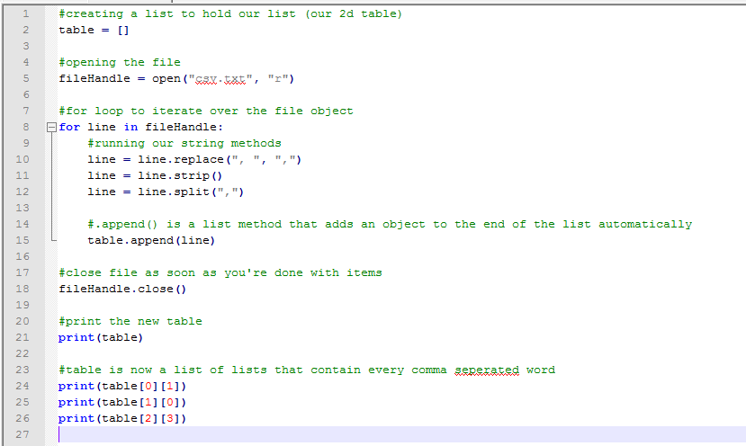
Putting it all together

Slide 19
Alternatively
import csv
help(csv)
There’s already a csv module in the standard library
Do some research first, try not to write code that’s already been written
Google is your friend

